Slide 1




PRESENTED BY
SMART PARKING SYSTEM
NAME | UNIVERSITY ROLL | CLASS ROLL
SOUVIK GHOSH | 10900220073 | 72
SOUMYAJYOTI MUKHERJEE | 10900220077 | 76
SOUMIK MONDAL | 10900220086 | 85
SRAYOAN RAY | 10900220113 | 112
SUVAM METIA | 10901320008 | 136
NETAJI SUBHASH
ENGINEERING COLLEGE
Under the guidance of Prof. Sukanta Bose
(Department of INFORMATION TECHNOLOGY)
( MAULANA ABUL KALAM AZAD UNIVERSITY OF TECHNOLOGY )

Slide 2
ABSTRACT
INTERNET OF THINGS(IoT)
DESCRIPTION OF THE COMPONENTS
CIRCUIT DIAGRAM
COMPONENT CONNECTIONS
PROJECT DEMO WITH IMAGE
FUTURE SCOPE
CONCLUSION
REFERENCES
CONTENTS

Slide 3
ABSTRACT
This project, titled "SMART PARKING SYSTEM" aims to develop a smart parking solution that efficiently manages vehicle entry and exit while providing real-time parking availability information. The system leverages ultrasonic sensors, a servo motor, LEDs, a buzzer, and an LCD display, all controlled by an Arduino Uno microcontroller.
The automated parking system features a barrier controlled by a servo motor, which opens and closes based on the detection of vehicles using ultrasonic sensors. The traffic light system, consisting of red, yellow, and green LEDs, regulates the entry and exit of vehicles, ensuring smooth traffic flow. The LCD display provides real-time updates on the availability of parking slots, enhancing user convenience.
The project is designed to address the challenges of manual parking management by offering an automated solution that reduces human intervention, enhances efficiency, and improves the user experience. By integrating various electronic components and sensors, this system demonstrates a practical application of IoT (Internet of Things) in the field of smart parking. The project includes detailed circuit design, component integration, and programming to achieve the desired functionality. It also incorporates safety features, such as a buzzer alert for full parking capacity, ensuring effective communication of parking status to users. This innovative approach to parking management showcases the potential of IoT technologies in creating smarter and more efficient urban infrastructure.

Slide 4
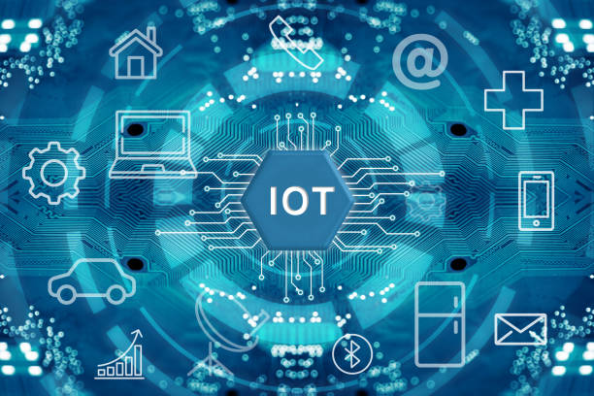
INTERNET OF THINGS(IoT)
The term IoT, or Internet of Things, refers to the collective network of connected devices and the technology that facilitates communication between devices and the cloud, as well as between the devices themselves.

Slide 5
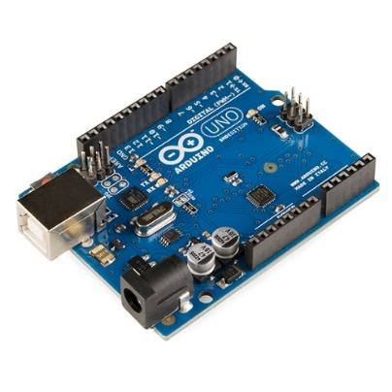
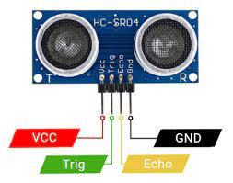
DESCRIPTION OF THE COMPONENTS
ARDUINO UNO –
The Arduino Uno is a popular open-source microcontroller board designed for simplicity and ease of use. It is part of the Arduino platform, which provides a versatile environment for creating interactive electronic projects. Its components are microcontroller , power , input/output pins , programming in Arduino uno IDE .
CONNECTING WIRES –
Used to connect the sensors with the breadboard , poles and other connectivity requirements.
ULTRASONIC SENSORS –An ultrasonic sensor is an electronic device that measures the distance of a target object by emitting ultrasonic sound waves, and converts the reflected sound into an electrical signal. Ultrasonic waves travel faster than the speed of audible sound (i.e. the sound that humans can hear). Ultrasonic sensors have two main components: the transmitter (which emits the sound using piezoelectric crystals) and the receiver (which encounters the sound after it has travelled to and from the target).

Slide 6
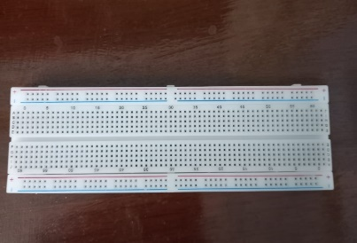
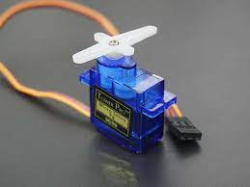
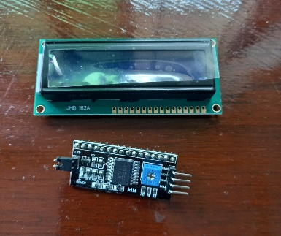
MINI BREADBOARD-
A mini breadboard is a small, portable version of a breadboard, which is a device used in electronics to prototype and test circuit designs. The main purpose of a breadboard is to allow engineers, students, and hobbyists to quickly and easily connect electronic components without soldering. It's a reusable platform for creating temporary circuits.
SERVO MOTOR-
A servo motor is a rotary actuator that allows for precise control of angular position. It consists of a motor coupled to a sensor for position feedback. It also requires a servo drive to complete the system. The drive uses the feedback sensor to precisely control the rotary position of the motor.
LCD MODULE -LCD (Liquid Crystal Display) screen is an electronic display module and find a wide range of applications. A 16x2 LCD display is very basic module and is very commonly used in various devices and circuits. These modules are preferred over seven segments and other multi segment LEDs. The reasons being: LCDs are economical; easily programmable; have no limitation of displaying special & even custom characters (unlike in seven segments), animations and so on. A 16x2 LCD means it can display 16 characters per line and there are 2 such lines.

Slide 7
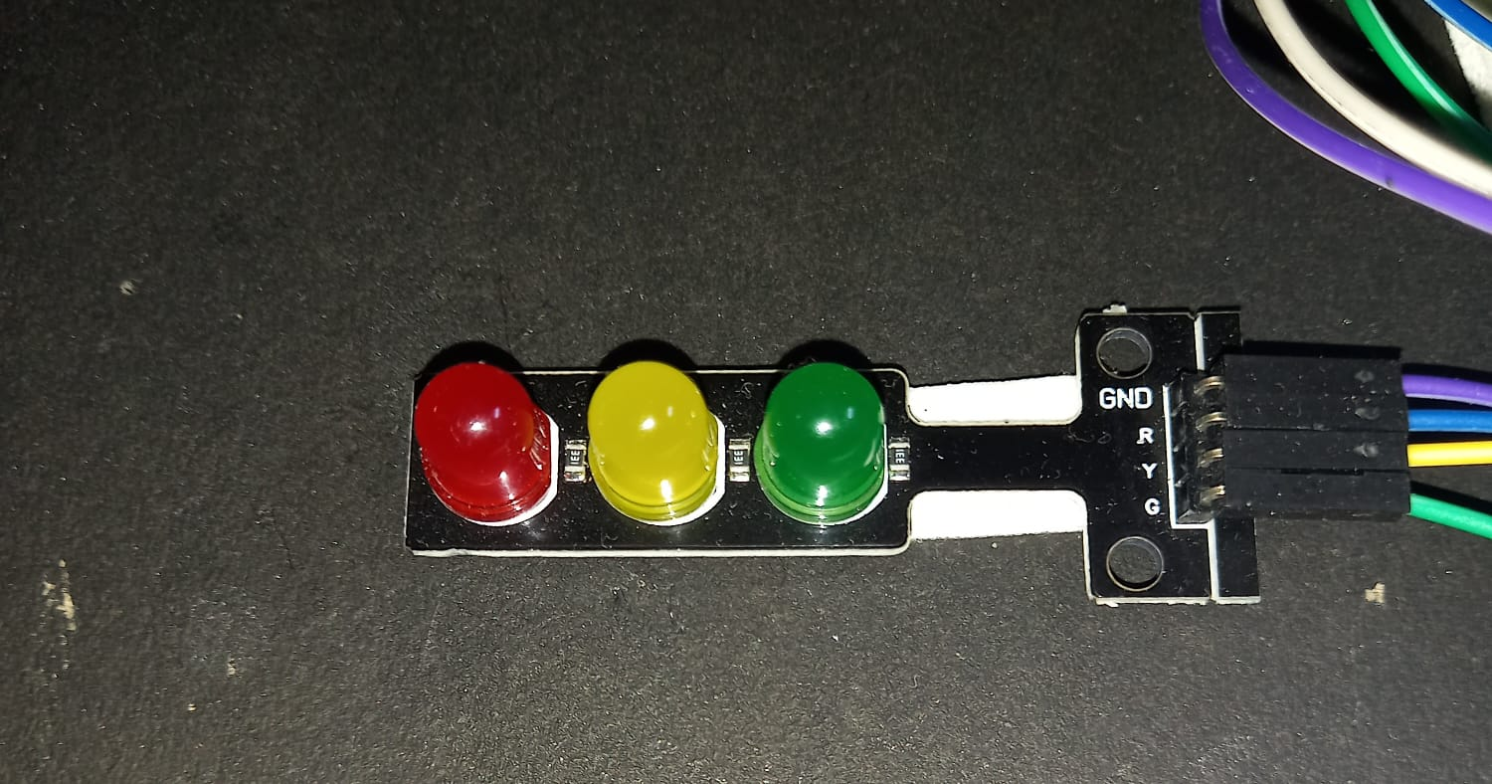
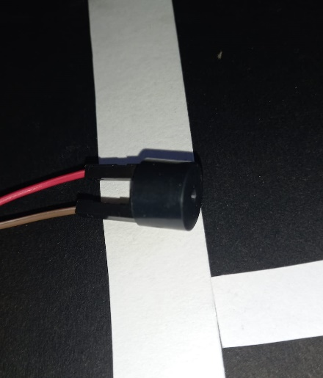
LED LIGHTS-
LED lights are used to depict the street light in our project. We have seen street lights on the road and that is depicted in our project. Sensors will light up the lights accordingly as programmed.
BUZZER-
As soon as the slots are filled up the buzzer will make a sound and it will give an alert that all the slots are filled up.

Slide 8
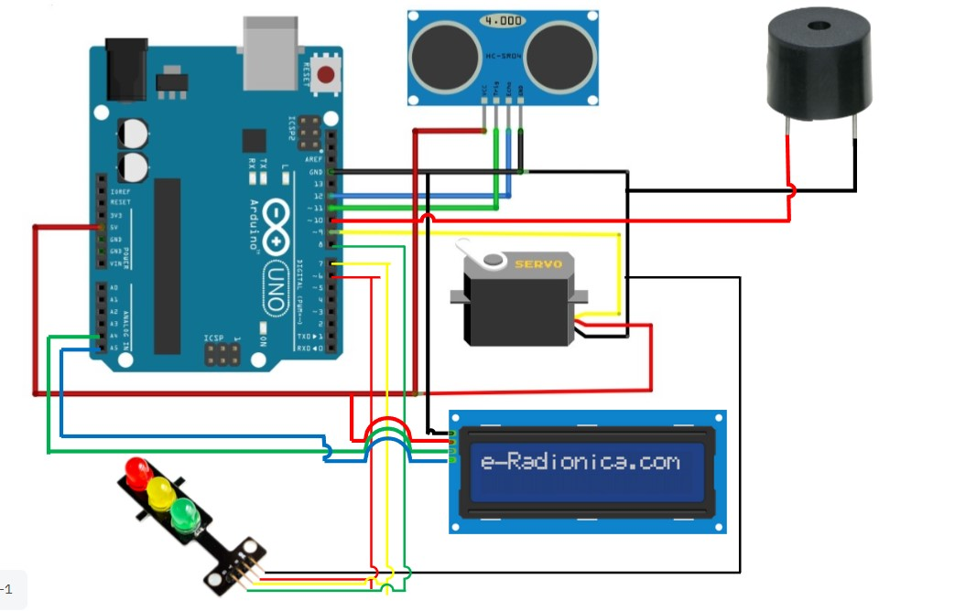
Circuit diagram

Slide 9
Component connections
.
Arduino Uno:
Central microcontroller that controls all components.
Ultrasonic Sensor:
VCC: Connects to the Arduino 5V pin.
GND: Connects to the Arduino GND pin.
Trig: Connects to Arduino digital pin 2.
Echo: Connects to Arduino digital pin 3.
Servo Motor:
Brown (GND): Connects to the Arduino GND pin.
Red (VCC): Connects to the Arduino 5V pin.
Orange (Signal): Connects to Arduino digital pin 10.

Slide 10
Traffic Light (LEDs):
Red LED:
Anode (longer leg) connects to Arduino digital pin 6.
Cathode (shorter leg) connects to the Arduino GND through a resistor (typically 220Ω).
Yellow LED:
Anode (longer leg) connects to Arduino digital pin 7.
Cathode (shorter leg) connects to the Arduino GND through a resistor (typically 220Ω).
Green LED:
Anode (longer leg) connects to Arduino digital pin 8.
Cathode (shorter leg) connects to the Arduino GND through a resistor (typically 220Ω).

Slide 11
Buzzer:
Positive (longer leg): Connects to Arduino digital pin 9.
Negative (shorter leg): Connects to the Arduino GND.
LCD Display with I2C Module:
VCC: Connects to the Arduino 5V pin.
GND: Connects to the Arduino GND pin.
SDA: Connects to the Arduino SDA (A4) pin.
SCL: Connects to the Arduino SCL (A5) pin.

Slide 12
Functionality
Initialization:
When the system initializes, the LCD displays a welcome message indicating the number of available slots.
Vehicle Detection:
When a vehicle is detected by the first ultrasonic sensor, the servo motor rotates to open the barrier, the yellow light turns off, and the green light turns on.
Once the vehicle passes the second ultrasonic sensor, the barrier closes, the green light turns off, and the yellow light turns back on.
The LCD updates to show the remaining number of slots.
Full capacity:
When all slots are filled, red light turns on and the buzzer sounds for a brief period and the LCD displays a “No slots left” message.

Slide 13
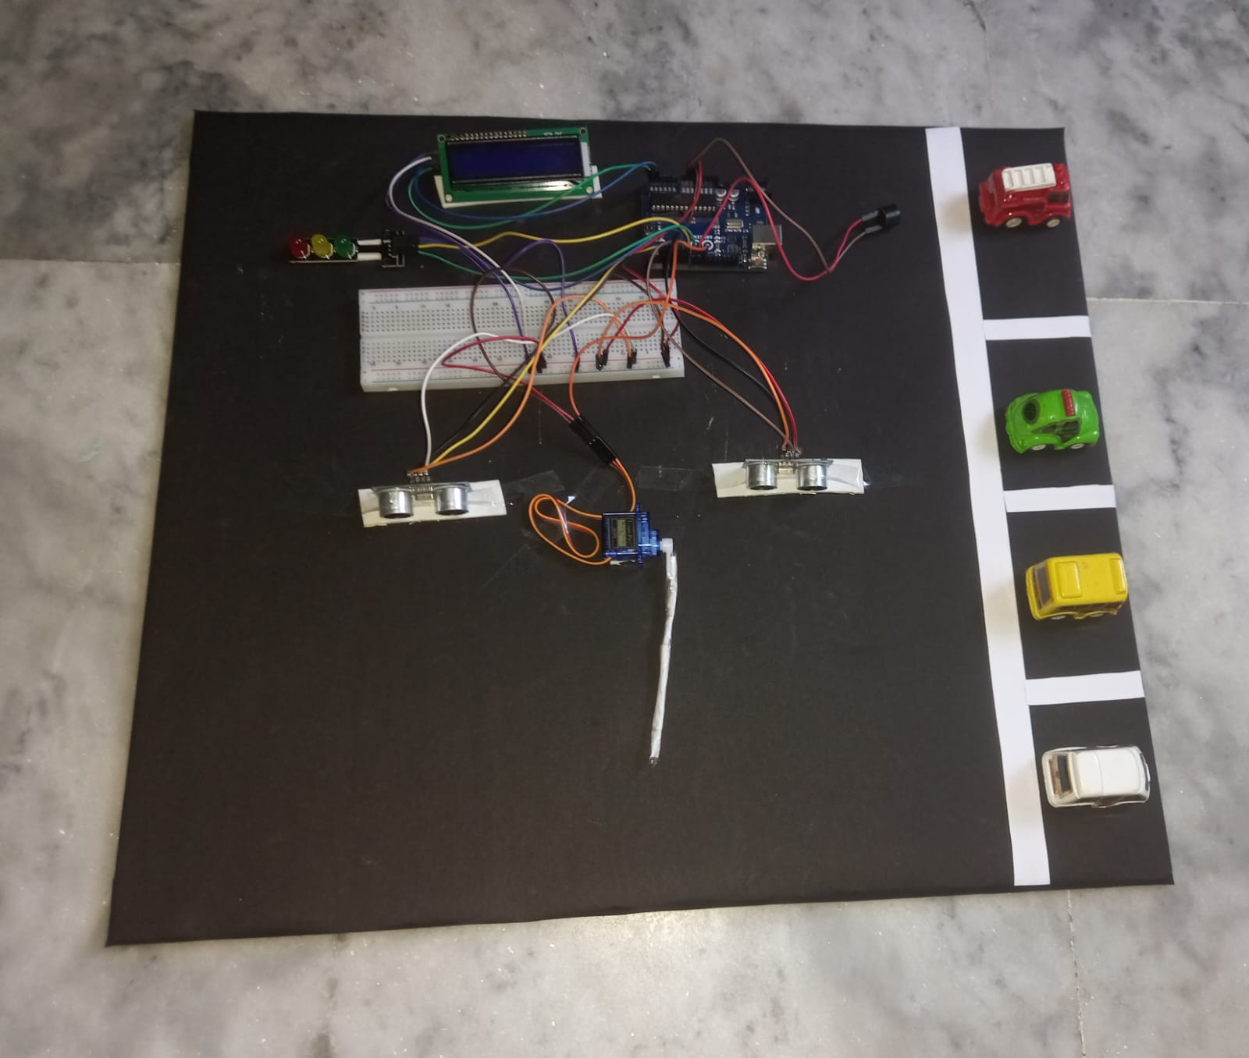
Project Demo link with image
Demonstration link :- https://youtu.be/9XBMm6LkfTw?si=Z1fdBKgrj8w9Quqp

Slide 14
FUTURE SCOPE
Enhanced Security Features:
Incorporate additional security features such as CCTV integration and automatic number plate recognition (ANPR) to monitor and log vehicle entries and exits. This can enhance the security and management of the parking area.
Energy Efficiency Improvements:
Utilize solar panels to power the system and implement energy-efficient components to reduce the overall power consumption. This can make the system more sustainable and cost-effective in the long run.
Scalability for Larger Facilities:
Expand the system's capability to manage larger parking facilities by incorporating multiple entry and exit points, and using a centralized database to track slot availability across various locations within a facility.
4. Remote Monitoring and Control:
Integrate the system with IoT technology to enable remote monitoring and control of the parking slots via a web interface or mobile app. This would allow users to check slot availability in real-time and reserve slots in advance

Slide 15
CONCLUSION
This project successfully demonstrates an efficient and automated car parking system using an Arduino-based platform. By integrating ultrasonic sensors, a servo motor, an LED traffic light, a buzzer, and an LCD display, we created a system that manages parking slots dynamically and provides clear visual and audio indicators to users.
The system begins by welcoming the user and displaying the number of available slots. As a car approaches, the ultrasonic sensors detect its presence and control the barrier accordingly, ensuring smooth entry and exit. The real-time updates on the LCD display enhance user experience by providing immediate feedback on slot availability.
Throughout the project, various components were interfaced with the Arduino Uno, showcasing the potential of microcontroller-based automation in real-world applications. The system's ability to handle multiple cars efficiently while ensuring proper signaling demonstrates its robustness and reliability.
Overall, this project not only meets the intended objectives but also lays a foundation for future enhancements such as remote monitoring, energy efficiency improvements, and integration with larger parking management systems. It serves as a practical example of how technology can be leveraged to solve everyday challenges, making parking management more effective and user-friendly.

Slide 16
REFERENCES
Research Papers:
"Intelligent Traffic Light Control System Using Internet of Things" by A. Elakkiya, S. Gokulapriya, and M. Prabhakaran.
"An IoT-Based Intelligent Traffic Management System" by S. M. H. F. Shuaib, N. A. Ismail, and A. A. M. Isa.
Books:
"Internet of Things (IoT) for Smart Cities" by Pethuru Raj, Anupama C. Raman, and K. G. Srinivasa.
"Building the Internet of Things: Implement New Business Models, Disrupt Competitors, Transform Your Industry" by Maciej Kranz.
YOUTUBE
4. Also our project guide Prof. Sukanta Bose helped us a lot on the ideas of the project along with the implementation of the project .
5. The group members – soumik mondal , souvik ghosh , soumyajyoti mukherjee , suvam metia and srayoan ray cooperated with each other a lot and helped each other to achieve a grand success of the project.
6. ChatGPT helped us in answering some queries which made us more confident on our work.

Slide 17


THANK YOU

